Slide 1
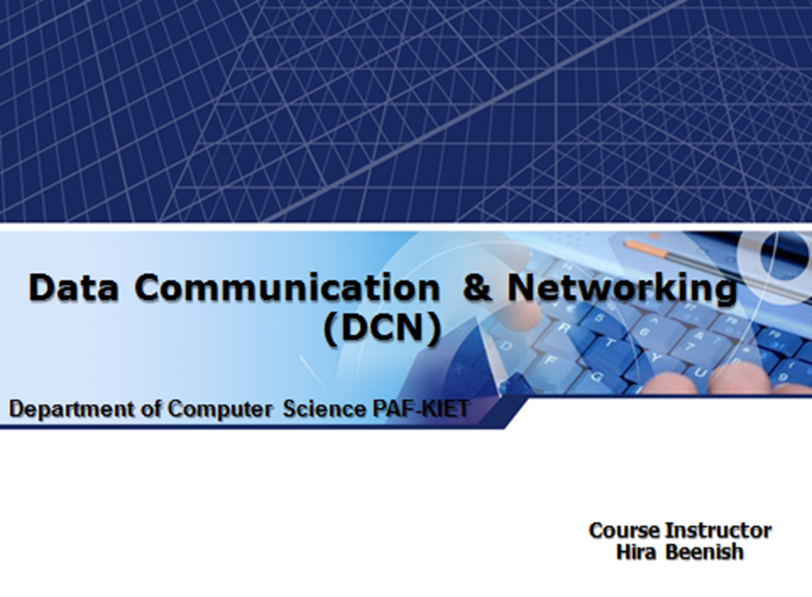

Slide 2
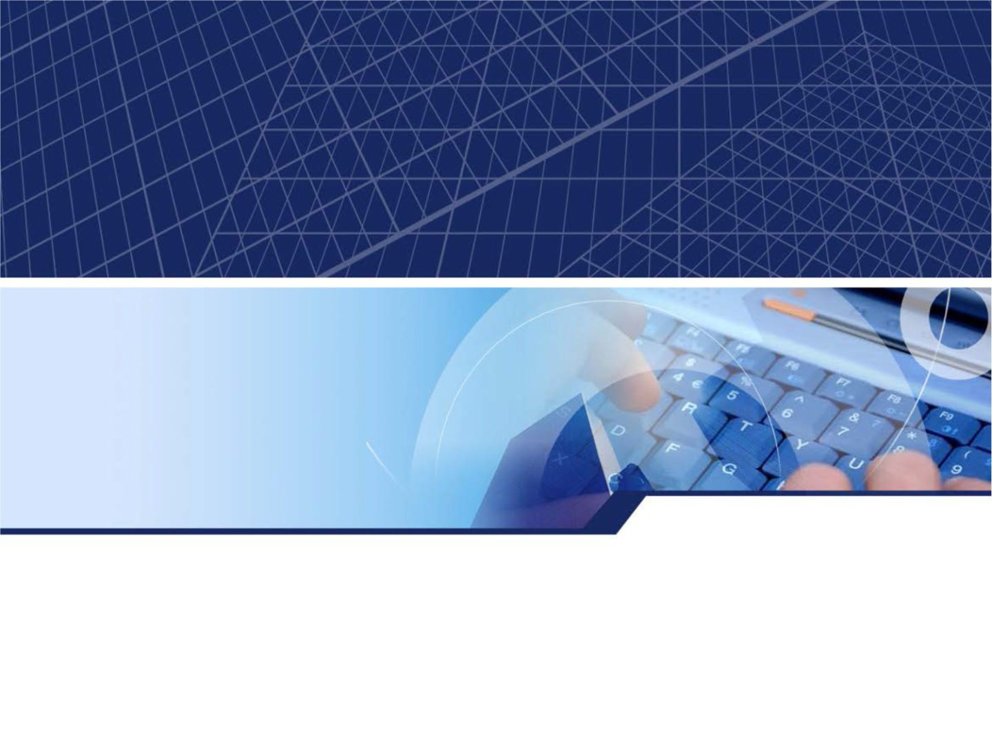
Chapter 5. Analog Transmission
4-1

Slide 3
DIGITAL-TO-ANALOG CONVERSION
A sine wave is defined by three characteristics: amplitude, freq uency, and phase. When we vary anyone of these characteristic s, we create a different version of that wave. by changing one c haracteristic of a simple electric signal, we can use it to represe nt digital data
Bit rate
Bit rate is the number of bits per second
Baud rate
Baud rate is the number of signal elements per second.

Slide 4
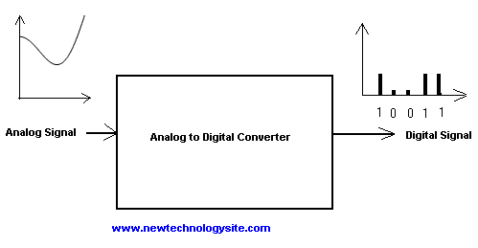
DIGITAL-TO-ANALOG CONVERSION
An Digital to Analog converter (DAC) takes a digital signal and converts it, through a mathematical function,
into an analog signal.

Slide 5
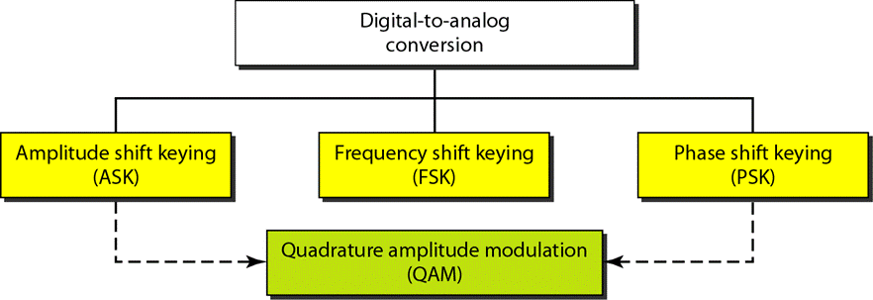
DIGITAL-TO-ANALOG CONVERSION
Types of digital-to-analog conversion

Slide 6
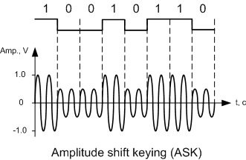
DIGITAL-TO-ANALOG CONVERSION
Amplitude Shift Keying
In amplitude shift keying, the amplitude o f the carrier signal is varied to create signal elements. Both frequency and phase remain constant while the amplitude changes.

Slide 7
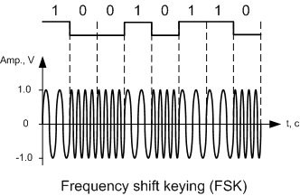
DIGITAL-TO-ANALOG CONVERSION
Frequency Shift Keying
In frequency shift keying, the fr equency of the carrier signal is varied to represent. Bot h peak amplitude and phase remain constant for all sig nal elements.

Slide 8
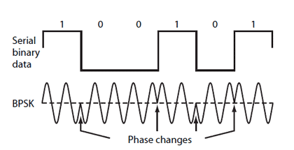
DIGITAL-TO-ANALOG CONVERSION
Phase Shift Keying
In phase shift keying, the phase of th e carrier is varied to represent two or more different si gnal elements. Both peak amplitude and frequency rem ain constant as the phase changes.

Slide 9
Quadrature Amplitude Modulation
(QAM) Quadrature amplitude modulation is a combination of ASK and PSK.
Bandwidth for QAM
The minimum bandwidth required for QAM transmi ssion is the same as that required
for ASK and PSK transmission. QAM has the same advantages as PSK over ASK.

Slide 10
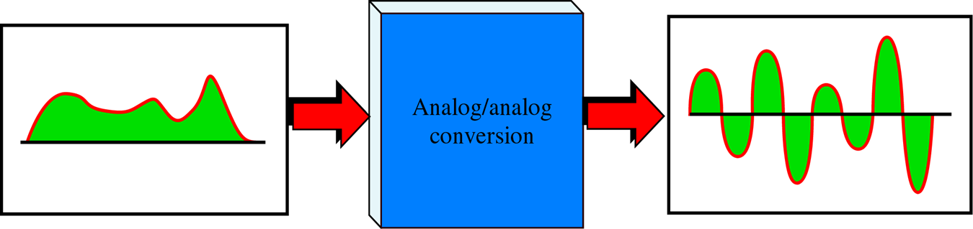
ANALOG-TO-ANALOG CONVERSION
It is the representation of analog information by an analog signal.
Analog to Analog conversion Example is Radi o.

Slide 11
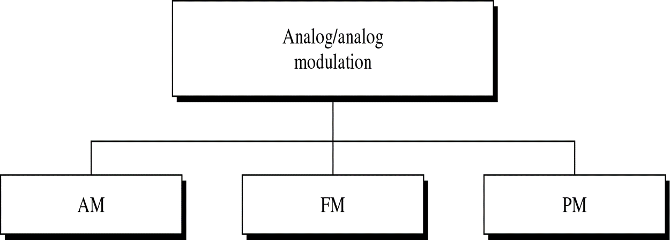
Types of analog-to-analog modul ation

Slide 12
Amplitude Modulation (AM)
Amplitude of carrier signal is changed according to the amplitude of modulating signal.
Frequency and phase remain the same.

Slide 13

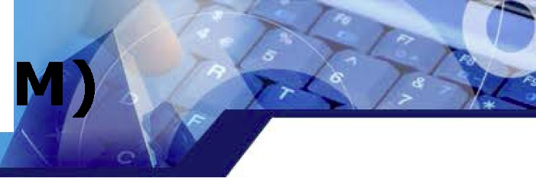
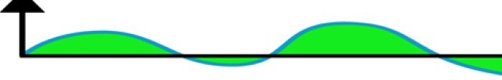
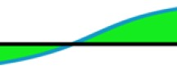
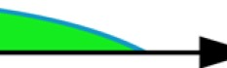
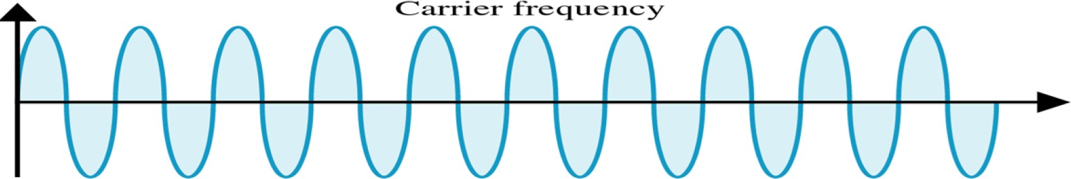

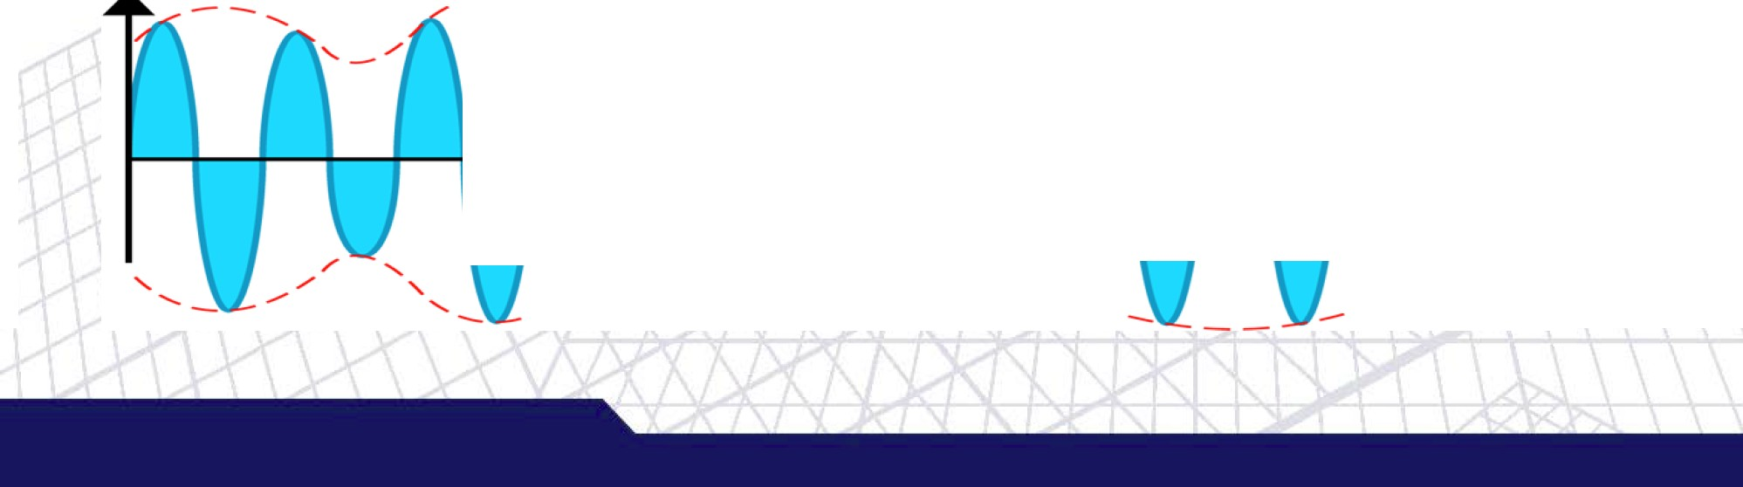
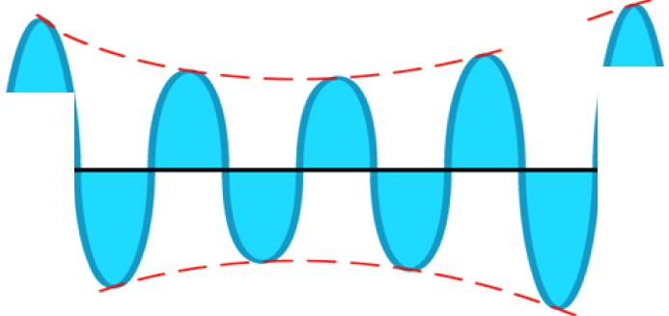
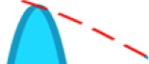
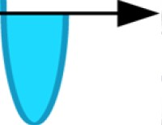

Amplitude Modulation (A
lVlodulat.ing
signal (audio)
--
--
-
-
AlVl signal
'
/ -
/
₋/
....... .......

Slide 14
Frequency Modulation (FM)
Frequency of carrier signal is changed accordi ng to the amplitude of modulating signal
Amplitude and Phase of the remain constant

Slide 15
Frequency Modulation (FM)
Amplitude
l\.llodulating
ignal (audio)
Ti 1ne
Amplitude

Slide 16
Phase modulation (PM)
In PM transmission, the phase of the carri er signal is modulated
Amplitude & Frequency of the carrier sign al remain constant

Slide 17
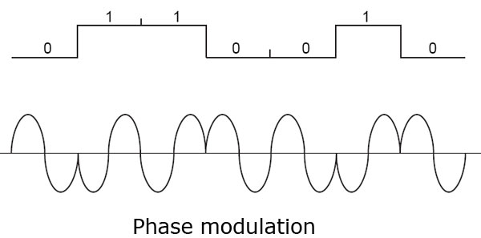
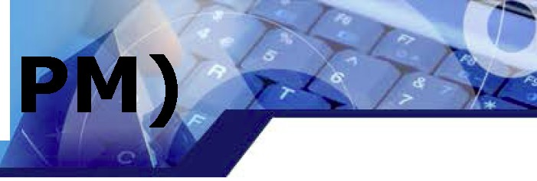
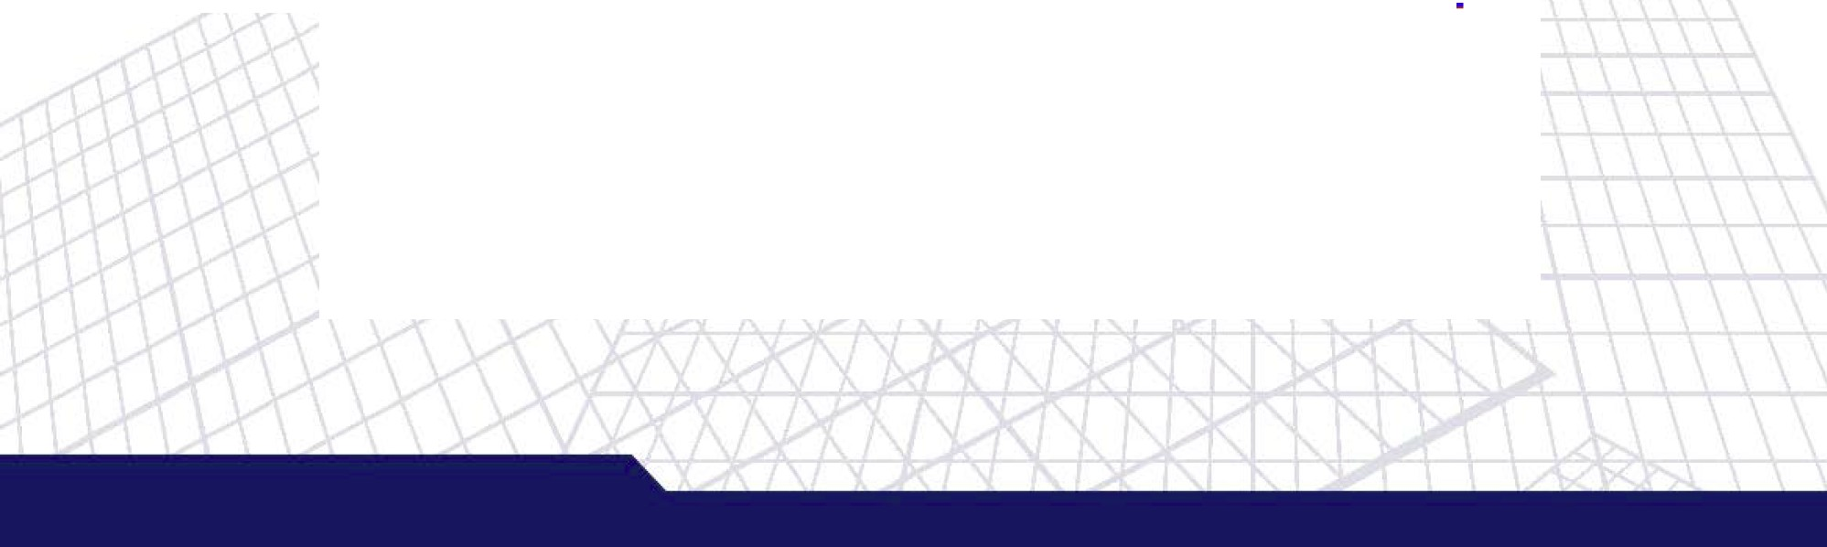
Phase modulation (
(ª\^{rrier}(\ (\ [\ [\ (\ (\ Av
C
v vvvvv v
Modulating 'V\Iave (d gita I)
I I
0
0
0
Modulated IR.e su1:
f\1\_{w}1_{v}\M_{v}f\_{v}1_{v}\f\

Slide 18
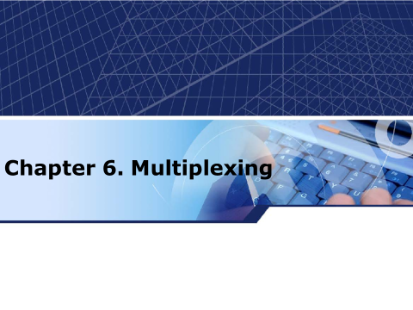

Slide 19

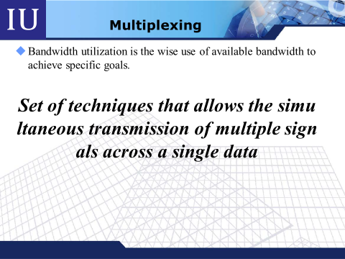

Slide 20
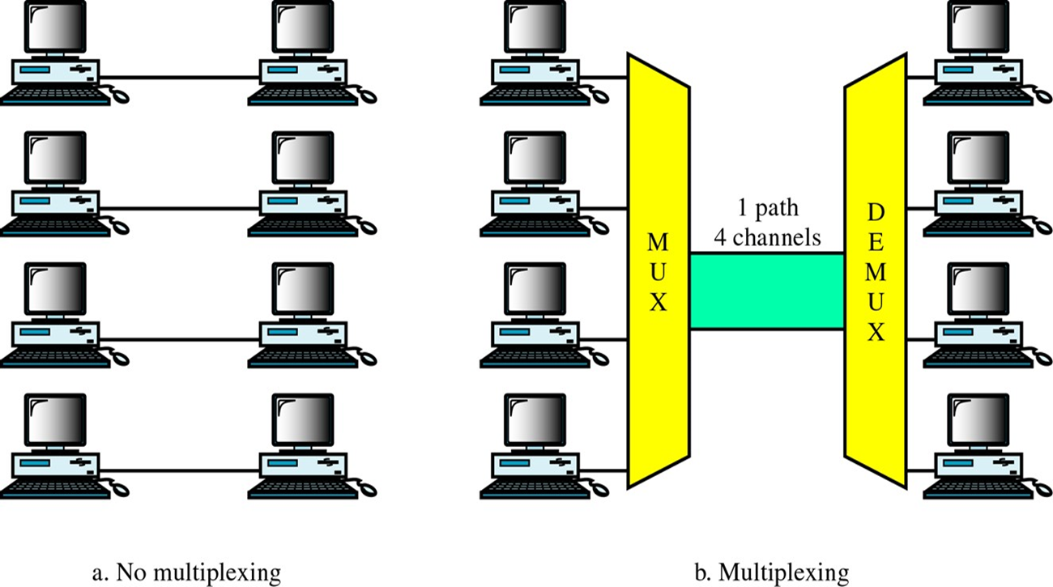
Multiplexing

Slide 21
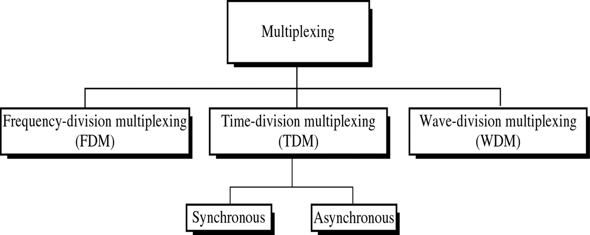
Categories of Multiplexing

Slide 22
Frequency-Division Multiplexing
FDM is an analog multiplexing technique that combi nes analog signals
Signals modulate different carrier frequencies Modulated signals are combined into a composite signal.
Channels can be separated by strips of unused band width (guard band) to prevent overlapping

Slide 23
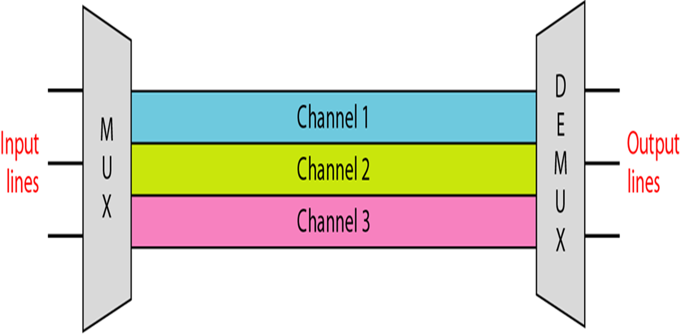
Frequency-Division Multiplexing

Slide 24
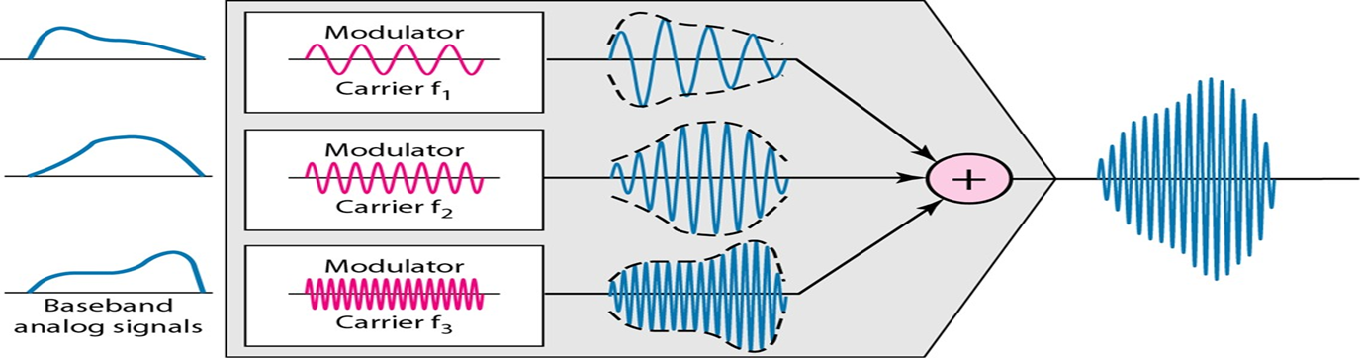
Frequency-Division Multiplexing
at the multiplexer (MUX) :
each source generates a signal of similar frequency range inside the multiplexer, these similar signals modulates different carrier frequencies (f1, f2 and f3)
the resulting modulated signals are then combined into a sin gle composite signal

Slide 25
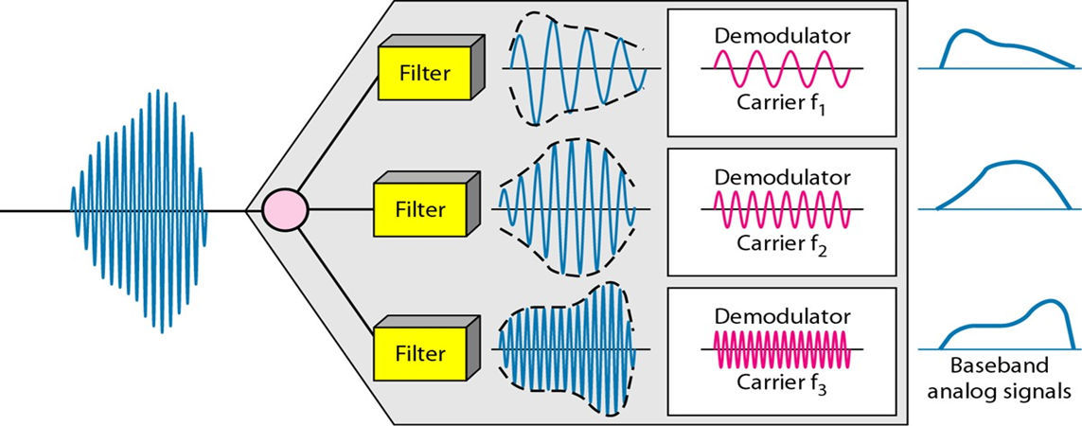
Frequency-Division DeMultiplexing
at the DE multiplexer (DEMUX) :
a series of filters are used to decompose the multiplexed signals into its original component signals
the individual signals are then passed to a demodulator that separates them from their carriers and passes them to the output lines

Slide 26
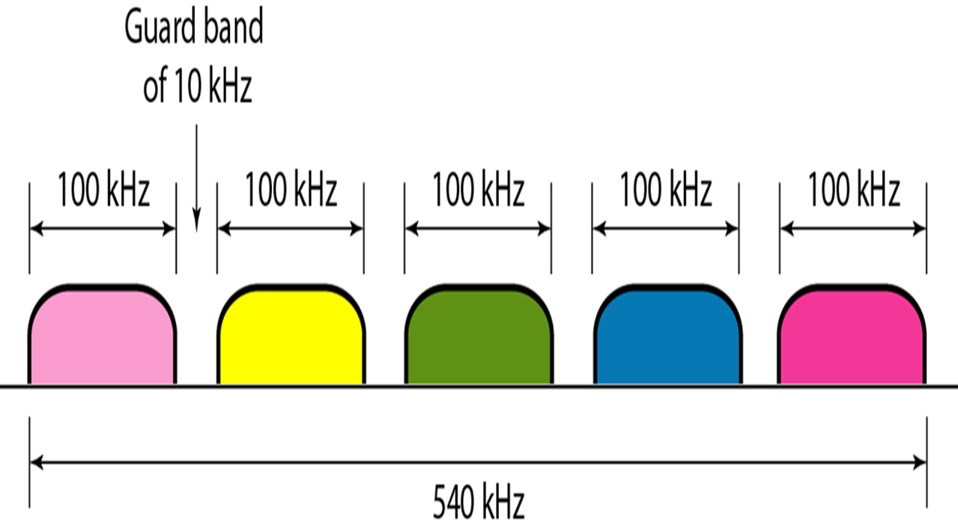
Frequency-Division DeMultiplexing

Slide 27
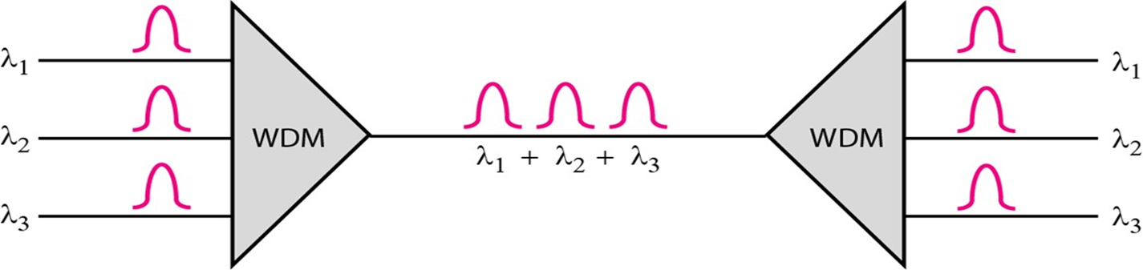
Wave Division Multiplexing(WDM)
designed to use the high-data-rate capability of fiber-optic c able
fiber optic cable data rate is higher that the metallic transmission cable data rate. Conceptually the same as FDM but involving with optical signals with higher frequency
Combining different signals of different frequencies (wavelengths)

Slide 28
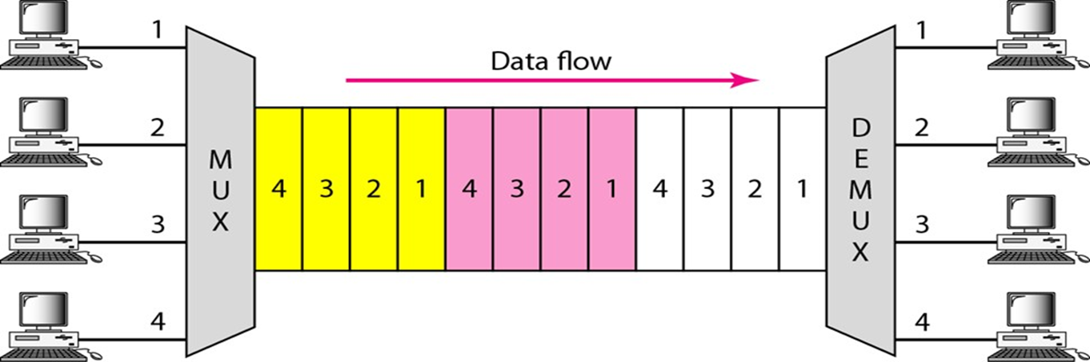
Time Division Multiplexing
Digital multiplexing technique for combining several low-rate channels into one high-rate one
Instead of sharing a portion of the bandwidth as in FDM, time is shared. Each connection occupies a portion of time in the link.

Slide 29
Time Division Multiplexing
TDM can be divided into 2 different schemes :
synchronous TDM :
Time allotment is given even no data is
sent
statistical TDM :
Time allotment is dynamically given to improve bandwidth efficiency

Slide 30
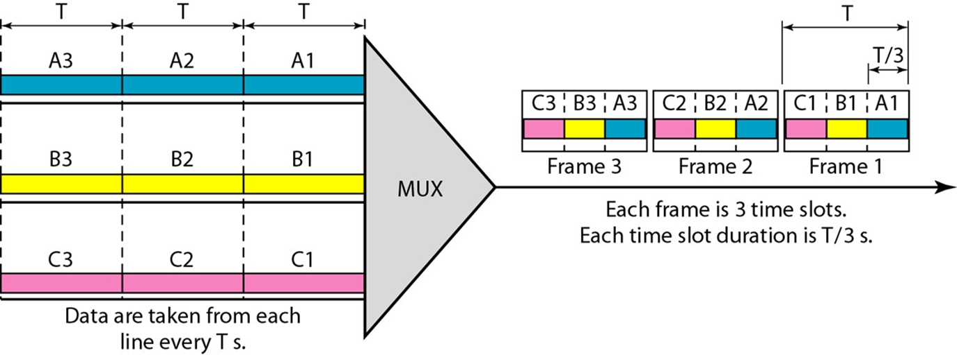
synchronous TDM
Data flow of each input connection is divided into units – each input occupies one input time slot.

Slide 31
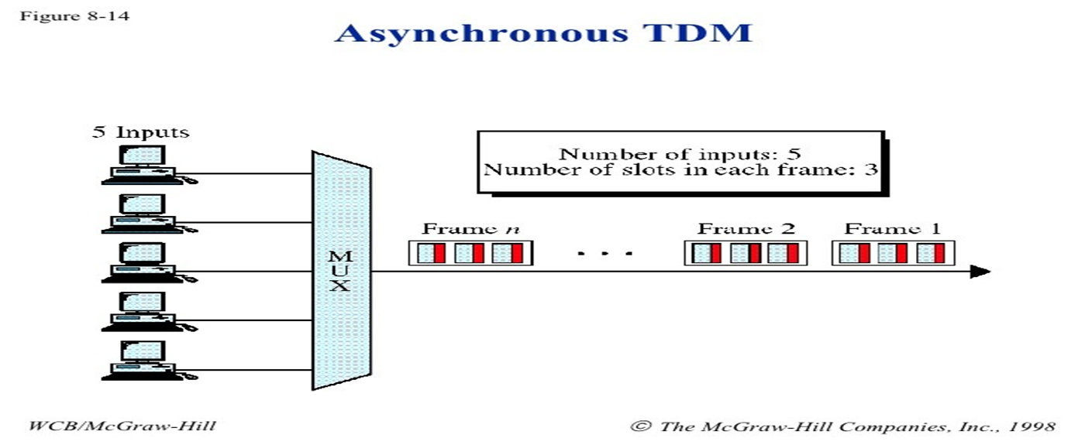
Asynchronous TDM
This type of multiplexing, time slots are not fixed i.e. the slots are flexible

Slide 32
Thank you

